Slide 1

Implementation of the age-structured SEIR epidemiology model for measles vaccination strategies Ziyabukwa Mthi Supervisor: Dr L. Bolton Co-supervisor: Mr. J. Bingham Department of Mathematical Sciences Stellenbosch University South Africa 30 August 2022

Slide 2
Content
Introduction
Research question
Aim of the research
Main objectives of the research
Study benefits
Mathematical model
Code design

Slide 3
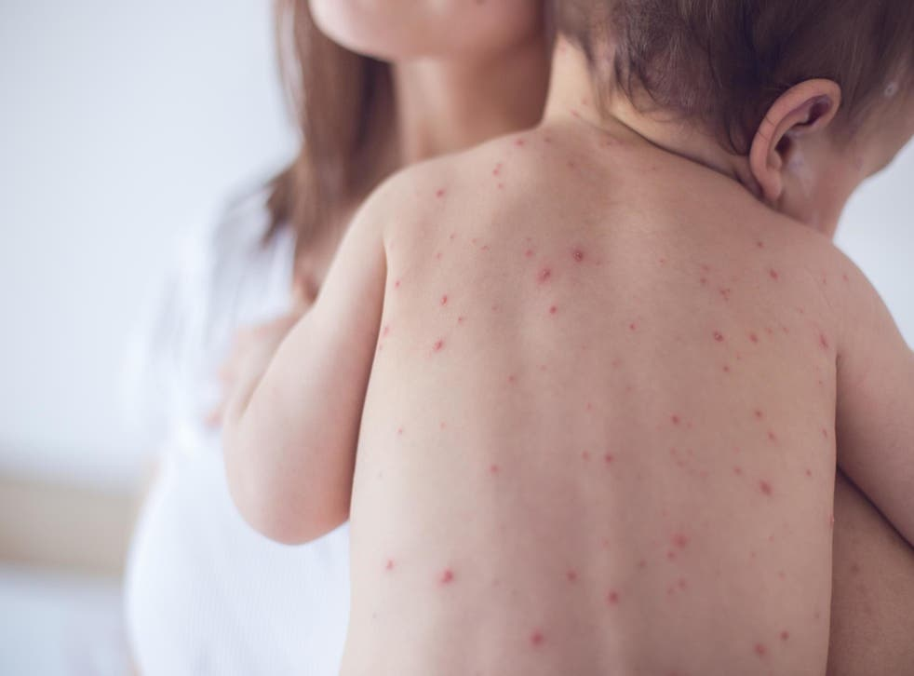
Introduction
Measles background
Measles is a Vaccine-Preventable Disease (VDP).
90% of exposed susceptible individuals are exposed to measles.
Incubation period: 10 – 14 days
52,600 confirmed mortality cases
Major cause of morbidity and mortality globally
Measles outbreak affecting children
https://www.independent.co.uk/news/health/measles-children-unicef-who-outbreaks-b2067129.html

Slide 4
Introduction
Measles vaccination
MMR 1 at 6 months
Vaccination Schedule
MMR 2 at 12 months
Measles Vaccine
Public Health Intervention
Vaccination awareness

Slide 5
Introduction
Discrete age structure
Age distribution
Non-uniformity in transmission rates
Application of measles vaccination strategies
Control of measles epidemics

Slide 6
Research question
How would different vaccination strategies influence the transmission of measles in population?

Slide 7
Aim of the research
Investigate the Measles SEIR epidemic model with discrete age groups to understand the transmission dynamics of an infectious disease in a host population with an age structure

Slide 8
Main objective of the research
Formulate a mathematical model for measles vaccination strategies and transmission dynamics.

Slide 9
Research objectives
To investigate transmission dynamics of measles in age-structured host population.
To study the vaccination strategies for measles with discrete age structure.
To analyse South African measles data and evaluate the effectiveness of various vaccination strategies for the country's measles epidemic control.
To compare the outcomes of various measles vaccination strategies recommended by NICD and the World Health Organization.
To utilize data on measles incidence from South Africa released by The National Institute for Communicable Diseases, develop an age-group vaccination model.

Slide 10
Study benefits
Determine the effectiveness of vaccination strategies and measles eradication targets for future predictions.
Assist in the analysis of the immune profile of the population and in each age group to establish the baseline and make projections.
The effect of increasing vaccine coverage to 95% or greater.
The impact of increasing the efficacy of two doses in reducing the effectiveness of measles incidence.

Slide 11
Methods
Mathematical Model
Model is deterministic and compartmental.
Host population is homogeneously mixed.
Per capita natural death and birth rates are both consistent over time.
Infants who receive the first and second doses of the vaccine consecutively develop a permanent immunity to the disease.
A host population of a constant size.

Slide 12
Methods
Mathematical Model
Developed SEIR model
Proportion of infants who received first dose of vaccine join the recovered class 1.
Infants who received second dose of vaccine join the recovered class 2.
Infant will be protected from measles by a successful vaccination

Slide 13
Methods
Implementation of measles vaccination methods
The efficacy of two doses of the measles vaccine ranges from 93% to 99%.
Vaccine coverage averaged 71,7% at 6 months and 76.4% at 12 months.
Develop a two-dose vaccination model with two age groups to study the vaccination strategies for measles epidemics

Slide 14
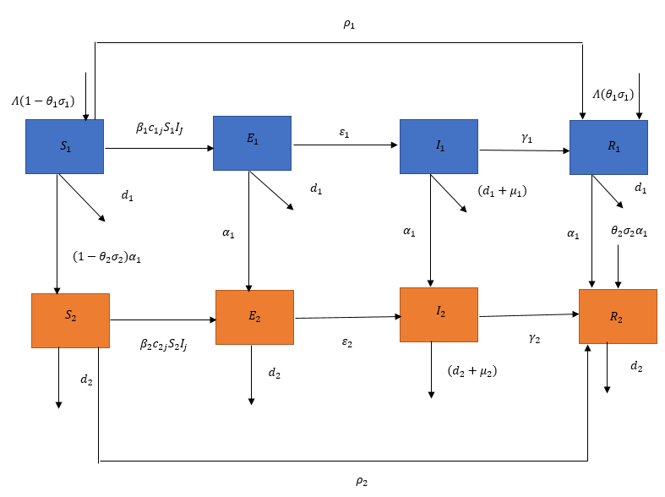
Methods
Measles vaccination model
Subdivide the host population into two age groups,
Considering age-specific differences in vaccination schedules, mortality, and contact patterns
Figure 1: Model diagram for a measles vaccination model with two age group.

Slide 15
Methods
Differential equations for age group 1:
Differential equations for age group 2:

Slide 16
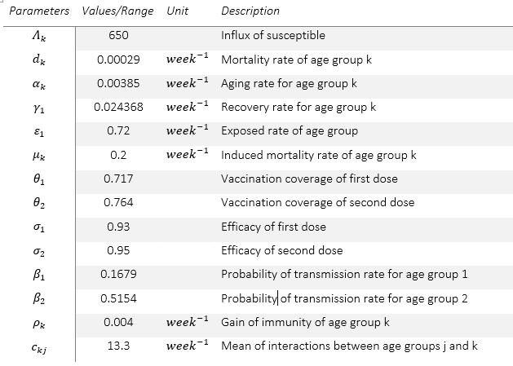
Methods
Model parameters and estimated values

Slide 17
Methods
Parameter’s estimation
State variables from published data
Estimated parameters by fitting model outcomes to measles data.
Reported annual incidence of measles.

Slide 18
Methods
Immune profile analysis
Evaluate sustained effort of measles vaccination strategies.
Examine the fraction of population that is protected by vaccination.
Examine the fraction that is protected by immunity due to past infection.

Slide 19
Methods
Improving vaccination coverage for measles
Explore different scenarios in which the vaccine coverage rate.
Implement the efficacy of 95% to the first dose that is administered to 6 months old

Slide 20
Code design
The model will be run in R studio (version 4.2.0) running R statistical software (version 4.2.0).
The R package tidyverse (version 1.3.2) will be used.
Function calculates the rate of change in each state variable
Ordinary Differential Equations (ODE’s)

Slide 21
References
L. Zhou, Y. Wang, Y. Xiao, and M. Y. Li, “Global dynamics of a discrete age-structured SIR epidemic model with applications to measles vaccination strategies,” Mathematical Biosciences 308, 27–37 (2019).
WHO Africa. Experts caution against stagnation of immunization coverage in Africa. 2019. Available at: https://www.afro.who.int/news/experts-caution-against-stagnationimmunization-coverage-africa
S. Edward, E. Kitengeso Raymond, T. Kiria Gabriel, F. Nestory, G. Mwema Godfrey, and P. Mafarasa Arbogast, “A mathematical model for control and elimination of the transmission dynamics of measles,” Applied and Computational Mathematics 4, 396–408 (2015)
O. Peter, O. Afolabi, A. Victor, C. Akpan, and F. Oguntolu, “Mathematical model for the control of measles,” Journal of Applied Sciences and Environmental Management 22, 571 (2018).
Moss, W.J. and Griffin, D.E., 2006. Global measles elimination. Nature Reviews Microbiology, 4(12), pp.900-908.
Battegay, R., Itin, C. and Itin, P., 2012. Dermatological signs and symptoms of measles: a prospective case series and comparison with the literature. Dermatology, 224(1), pp.1-
Enanoria, W.T., Liu, F., Zipprich, J., Harriman, K., Ackley, S., Blumberg, S., Worden, L. and Porco, T.C., 2016. The effect of contact investigations and public health interventions in the control and prevention of measles transmission: A simulation study. PloS one, 11(12), p.e0167160.
Centers for Disease Control and Prevention. Measles. Epidemiology and Prevention of Vaccine-Preventable Diseases. Hamborsky J, Kroger A, Wolfe S, eds. 13th ed. Washington D.C. Public Health Foundation, 2015.
Coale, A.J., 1957, January. How the age distribution of a human population is determined. In Cold spring harbor symposia on quantitative biology (Vol. 22, pp. 83-89). Cold Spring Harbor Laboratory Press.
Zhang, Z., Qiao, X., Yang, S. and Jiang, X., 2018. Non-uniform distribution of contamination on composite insulators in HVDC transmission lines. Applied Sciences, 8(10), p.1962.
Marelli, A.J., Mackie, A.S., Ionescu-Ittu, R., Rahme, E. and Pilote, L., 2007. Congenital heart disease in the general population: changing prevalence and age distribution. Circulation, 115(2), pp.163-172
National Institute Communicable Diseases. OUTBREAK RESPONSE UNIT, DIVISION OF PUBLIC HEALTH SURVEILLANCE AND RESPONSE; CENTRE FOR VACCINE AND IMMUNOLOGY. 2002. https://www.nicd.ac.za/wpcontent/uploads/2022/06/Measles-Vaccine-FAQ-_20220608.pdf
National Institute Communicable Diseases. ANNUAL MEASLES, RUBELLA AND CONGENITAL RUBELLA SURVEILLANCE REVIEW, SOUTH AFRICA, 2019

Slide 22

Thank you
Enkosi
Dankie
Photo by Stefan Els

